Slide 1

YAML FILE
YET ANOTHER MARKUP LANGUAGE
Indentation is very important in YAML.
In Azure DevOps, Pipelines helps to setup Continuous Integration/ Continuous Deployment

Slide 2
Component of YAML Pipeline
Stages : Stage is collection of Jobs which runs sequentially
Jobs: Job is Collection of Steps that runs on agents/environment.
Steps: Steps helps to define the set of process to setup your task or any activity which you want to perform on any specific job.
Kind of Steps:
Task
Script
Template reference

Slide 3
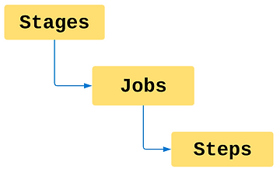
Hierarchy of YAML File

Slide 4
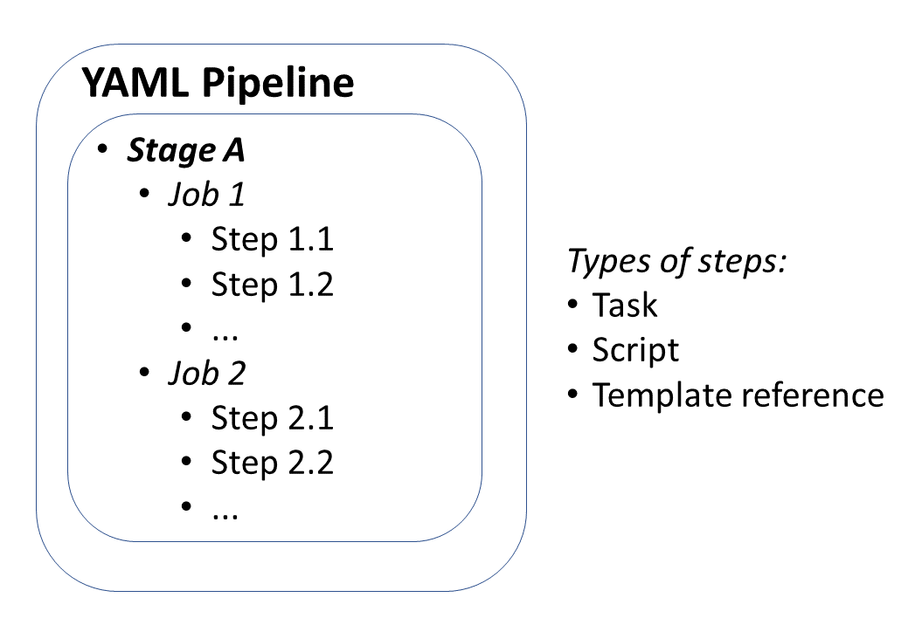

Slide 5
Hierarchy of YAML File
stages:
- stage: Build
jobs:
- job: Build Package
steps:
- Build
- Package
- Publish
- stage: Deploy
jobs:
- job: start Deployment
steps:
- Deploy package

Slide 6
- stage: Build
displayName: Build and push stage
jobs:
- job: Build
displayName: Build job
pool:
vmImage: $(vmImageName)
steps:
- task: Docker@2
displayName: Build and push an image to container registry
inputs:
command: buildAndPush
repository: $(imageRepository)
dockerfile: $(dockerfilePath)
containerRegistry: $(dockerRegistryServiceConnection)
tags: |
$(tag)

Slide 7
YAML PIPELINE TYPES
Single Stage, Single Job YAML Pipeline
Single Stage Multi Job YAML Pipeline
Multi Stage YAML Pipeline

